Slide 1
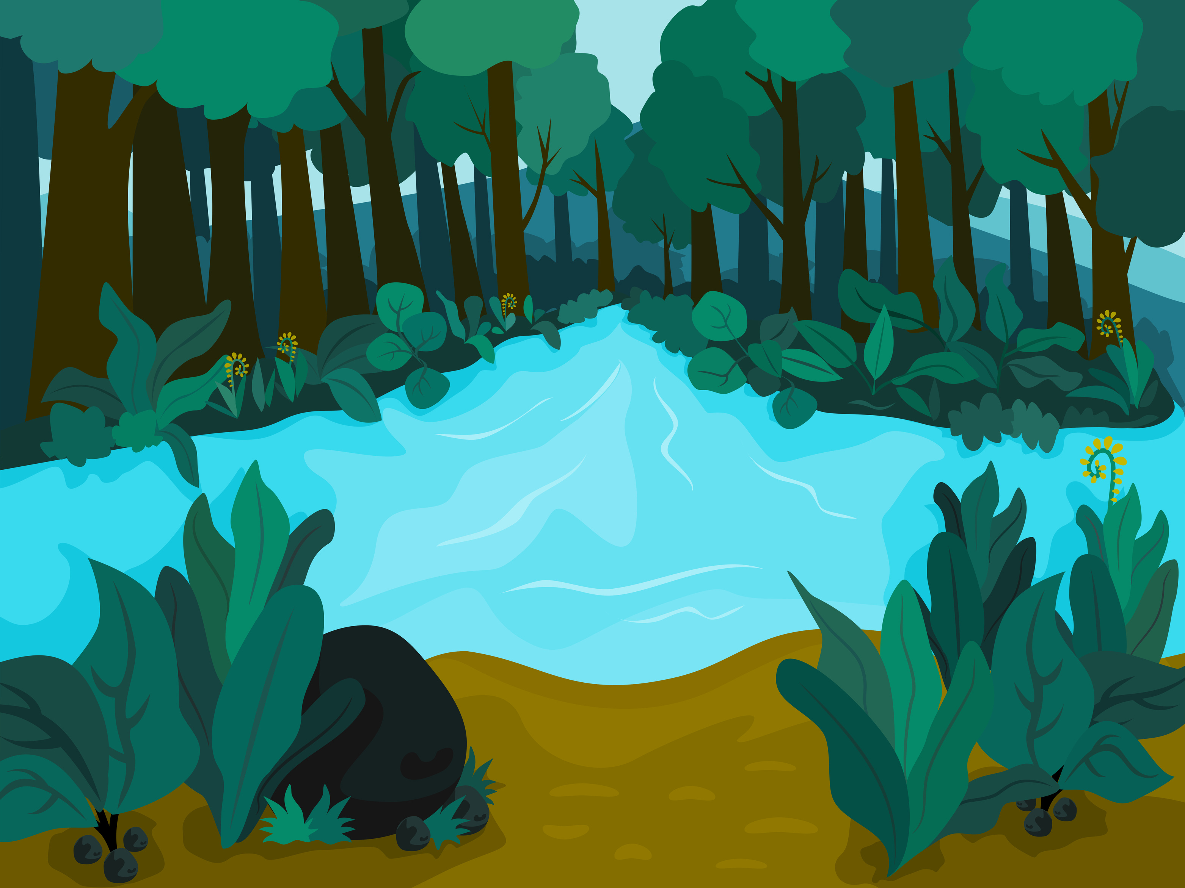
Forest Cover Change Detection using Remote Sensing & GIS : Impacts on
Environment & Hydrology
-A Data-Driven Approach for Sustainable Resource Management

Slide 2

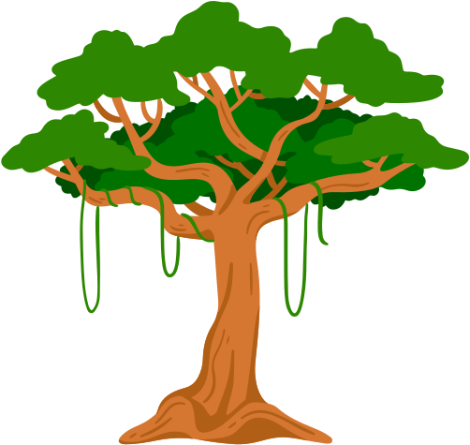
TEAM
Yarramsetti Jaswanth Venkat
RA2311003010656
Kanumuri V S L I Anooha
RA2311026010354

Slide 3

PROBLEM STATEMENT

Slide 4

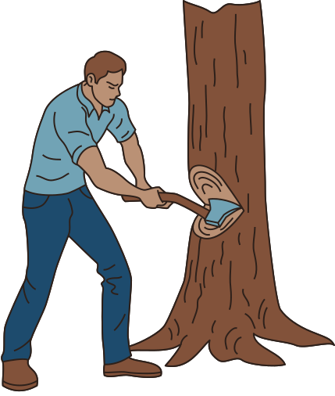
Forests Are Disappearing-And It’s Hurting Our Planet
Forests aren’t just trees — they’re Earth’s lungs and water factories. When we cut them down, everything breaks: animals lose homes, rivers dry up or flood, farms suffer. So, our project comes in — using satellites and smart mapping to See the damage and Fix it fast
🌳 Deforestation = Disaster
→ Loss of wildlife, hotter climate, dying soil.
💧 Water Systems in Trouble
→ Less forest = less rain soaking into ground → more floods AND droughts.
📉 Old Methods Don’t Work
→ Walking through forests with clipboards? Too slow. Too small. Too late.

Slide 5
Our Mission
-Project Goal

Slide 6
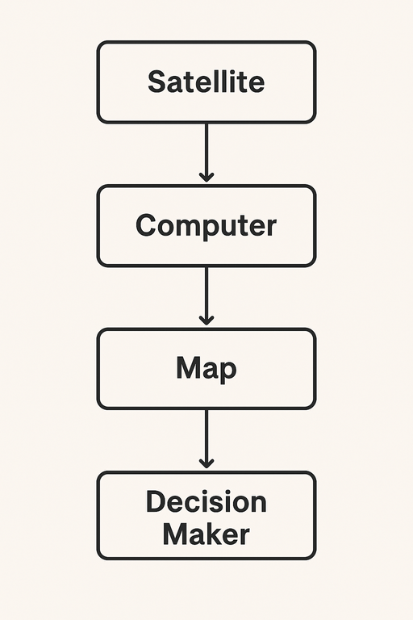


Our Solution: Eyes in the Sky, Brains on the Ground
This project leverages Remote Sensing (RS) and Geographic Information Systems (GIS) to:
Detect precise forest cover changes over time (e.g., 2000 vs. 2020).
Analyze the direct impact of these changes on water resources and the environment.
Visualize insights to empower smarter, sustainable land and water management decisions.

Slide 7
The Arsenal
-Data & Tools

Slide 8


Our High-Tech Toolkit
🛰️ Satellite Imagery
Landsat: Long-term history (since 1972), 30m resolution.
Sentinel-2: Super detailed (10m), recent, high-quality
🌍 GIS Layers
→ Digital Elevation Model (DEM) for terrain analysis
💧 Water & Land Data
→ Rivers, rainfall, watershed boundaries
🌳 Forest Data
→ Global Forest Change (Hansen et al.)

Slide 9
The Battle Plan
-Methodology

Slide 10
Step 1: Data Collection
Downloaded Landsat/Sentinel images for two key time periods (e.g., 2000 & 2020)
Step 2: Pre-processing
Cleaned the data: removed clouds, corrected atmospheric distortions, enhanced images
Step 3: Forest Classification
Taught the computer to spot forests using NDVI (greenness index) and machine learning (Random Forest).
Step 4: Change Detection
Compared the 2000 and 2020 forest maps to find exactly where forests were lost or gained
Step 5: GIS Analysis (The Magic!)
Overlaid our forest change maps with rivers, watersheds, and terrain (DEM) to see the environmental impact
Example: "Did forest loss near a river correlate with higher erosion risk?"
Step 6: Visualization
Created stunning, easy-to-understand maps, graphs, and stats to tell the story

Slide 11
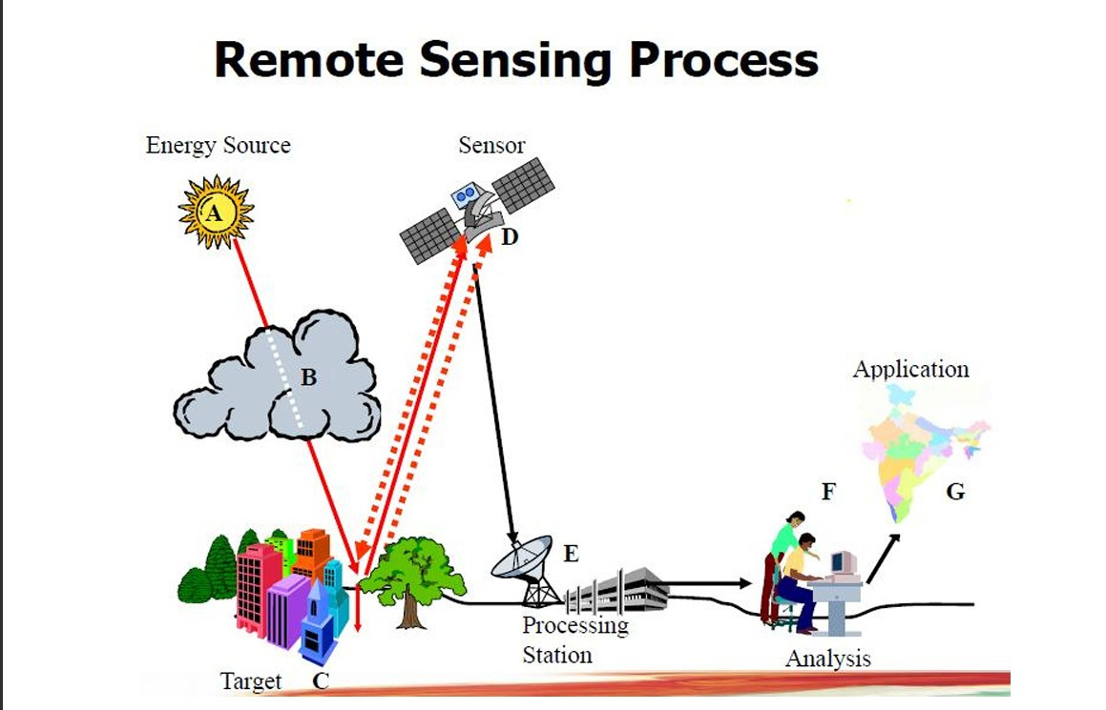

Slide 12

Observation
-Expected Results & Insights

Slide 13
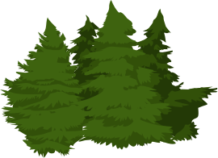
What We Expect to Find
📊 Quantifiable Change: X square kilometers of forest lost between 2000-2020
🗺️ Hotspot Maps: Identified critical deforestation zones and areas of natural regeneration
💧 Cause & Effect: Demonstrated how forest loss near watersheds leads to reduced water quality/quantity and increased soil erosion
🎯 Actionable Insights: Provided clear visual evidence to guide policies for sustainable forest-water-agriculture balance.

Slide 14

CONCLUSION
Remote Sensing (RS) and Geographic Information Systems (GIS) are more than just technological tools—they are essential instruments for understanding and safeguarding our planet. This project demonstrates how these technologies can provide clear, visual evidence of human impacts on critical ecosystems, such as forests and water resources. By analyzing changes over time, we can identify patterns, assess risks, and support informed decision-making for sustainable resource management and conservation efforts. Ultimately, gaining insight into these changes empowers us to take proactive steps, ensuring a healthier environment and secure water future for generations to come.

Slide 15


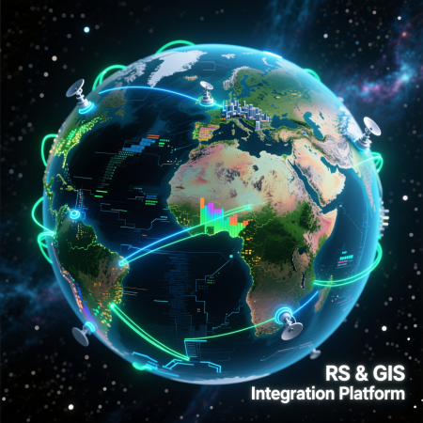

Slide 16
Thank you

